Slide 1

Guided Pathways

Slide 2
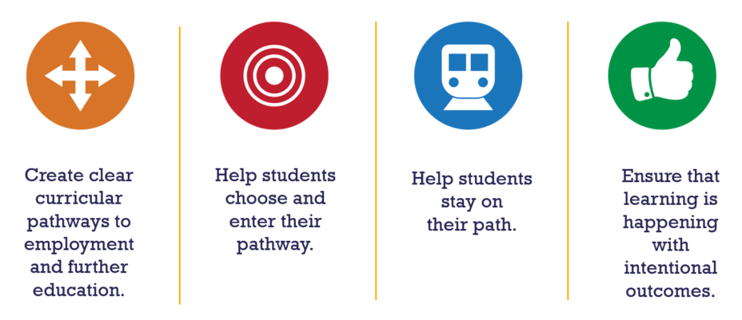
Guided Pathways, 1.0
Notes:
Alicia

Slide 3
Guided Pathways, 1.0
Early Momentum Metrics
What percentage complete 12 or more credits their first term?
15%
What percentage complete 36 or more credits their first year?
8%
Notes:
alicia

Slide 4

Guided Pathways, 1.0
Enter Guided Pathways, 2.0
Notes:
Alicia

Slide 5


Guided Pathways, 2.0
Notes:
Betsy

Slide 6

Guided Pathways, 2.0
Notes:
Betsy

Slide 7
Guided Pathways, 2.0
COCC’s top 10 programs
Undecided
Notes:
Betsy

Slide 8
Guided Pathways, 2.0
Exploratory Students: First Term
Rank | Course | # Program Students | % Program Students
1 | WR 121: English Comp | 48 | 32%
2 | HD 100CS: College Success | 47 | 31%
3 | MTH 95: Inter. Algebra | 18 | 12%
4 | MTH 111: College Algebra | 18 | 12%
5 | SP 111: Public Speaking | 13 | 9%
6 | WR 65: Rhet/Crit Thinking II | 11 | 7%
7 | SP 218: Interpersonal Comm | 11 | 7%
8 | HHP 185: Weight Training | 9 | 6%
9 | BA 101: Intro to Business | 9 | 6%
10 | HD 110: Career Planning | 9 | 6%
>10 | 121 other courses
BORING!
Notes:
Betsy

Slide 9
Guided Pathways: COCC
Notes:
Alicia

Slide 10
2021-22 Work Groups
Ask: Student Career Path
Academic and Career Communities
Multi-Year Plan
Notes:
Alicia

Slide 11
2021-22 Work Groups
Ask: Student Career Path
Academic and Career Communities
Multi-Year Plan
Notes:
Alicia

