Slide 1

2023 – 27 Strategic Plan
College Sustainability
Strategic Goal Update
Board of Directors’ July 2026 Meeting
Michael LaLonde, VP for Finance & Operations
Owen Murphy, Co-Chair PCLC
Laura Boehme, VP for People & Technology

Slide 2
College Sustainability Goal
COCC creates processes and systems to foster high-quality and operationally sustainable work, learning, and natural environments.
Indicators:
President’s Climate Leadership Commitment
Employee Turnover Rate
Employee Awards, Recognitions, Celebrations and Professional Development
GOAL

Slide 3
Facilities Master Planning
President’s Climate Leadership Commitment
Upgrade Business Operations
Employee Awards, Recognitions, Celebrations, and Professional Development
Culturally Inclusive Hiring Practices
ACTION PROJECTS

Slide 4
Facilities Master Planning Team
Building advocate program continues
3D models of the architectural designs and building layouts continues
Campus-wide input – sustainability, faculty, staff, students - all campuses
Space utilization assessment
Building quality assessments
Deferred maintenance evaluation
Facility master planning options
COLLEGE SUSTAINABILITY ACTION PROJECTS
Notes:
Building Advocates: created portable electronic inventory questionnaire, created a building advocate training program and trained the building advocates.
Define adult learners: (25+)
Introduce this slide by sharing that a COCC team – Tyler, Andrew, Breana, Cindy and Aimee – attended a statewide meeting on how to recruit and retain adult students. What we learned at that conference is that we are already engaged in most of the best practices and therefore, are not actively implementing new services – instead, we will refine many of our existing strategies and communications. Notes on the above bullets:
Updating Adult-Focused Imagery: MPR has focused on this and recently hired a position specifically to enhance imagery that connects with all of our student populations.
Academic Maps: Currently being developed through our Guided Pathways work.
Consistent Schedules: A workgroup is in place that has developed a year-long schedule and will work towards implementing a scheduling tool through CourseLeaf to help create consistent schedules for students.
Credit for Prior Learning: Through grant funding, we have been updating processes, identifying areas of need, and implementing Credit Predictor Pro, a tool that will help students easily submit and track their progress on CPL.
Corequisite Support for College Math and English: Currently in place for writing and some math courses.
Intentional Outreach to Stopped-Out Students: We recently launched a strategic outreach campaign for stopped-out students, which includes video, email communications, and a dedicated webpage.
Debt Forgiveness and Transcript Release: We changed our policy about a year ago to remove the debt hold on student accounts for transcripts.

Slide 5





Facilities Master Plan Timeline*
Facilities Master Plan RFP Process Complete
COLLEGE SUSTAINABILITY ACTION PROJECTS
Approval, Road Mapping & Planning
2024 –2025
Fall 2025
Spring 2026
Summer 2026*
Fall 2026
Project Planning & Space Utilization Baseline Assessment
Comprehensive Campus Facilities Plan Developed
Facilities Master Plan & Implementation Strategy Finalized
* Dependent on vendor selection

Slide 6
President's Climate Leadership Commitment
Accomplishments
  Updated Building Management Systems (BMS) to optimize heating & AC operation times
  Installed energy monitoring meters - all Bend Campus Buildings
  Waste diversion from Wickiup move out – donated reusable goods to local non-profits.
  Pacific Power use of cleaner energy
  Natural gas usage decrease 16%
  Trained building advocates
  College-wide gas emissions inventories for 2024 and 2025
Opportunities – natural gas consumption, electrify gas fired heating and cooking, on-site solar, commuting survey, roofing, HVAC systems, boilers
COLLEGE SUSTAINABILITY ACTION PROJECTS
Notes:
Building Advocates: created portable electronic inventory questionnaire, created a building advocate training program and trained the building advocates.
Define adult learners: (25+)
Introduce this slide by sharing that a COCC team – Tyler, Andrew, Breana, Cindy and Aimee – attended a statewide meeting on how to recruit and retain adult students. What we learned at that conference is that we are already engaged in most of the best practices and therefore, are not actively implementing new services – instead, we will refine many of our existing strategies and communications. Notes on the above bullets:
Updating Adult-Focused Imagery: MPR has focused on this and recently hired a position specifically to enhance imagery that connects with all of our student populations.
Academic Maps: Currently being developed through our Guided Pathways work.
Consistent Schedules: A workgroup is in place that has developed a year-long schedule and will work towards implementing a scheduling tool through CourseLeaf to help create consistent schedules for students.
Credit for Prior Learning: Through grant funding, we have been updating processes, identifying areas of need, and implementing Credit Predictor Pro, a tool that will help students easily submit and track their progress on CPL.
Corequisite Support for College Math and English: Currently in place for writing and some math courses.
Intentional Outreach to Stopped-Out Students: We recently launched a strategic outreach campaign for stopped-out students, which includes video, email communications, and a dedicated webpage.
Debt Forgiveness and Transcript Release: We changed our policy about a year ago to remove the debt hold on student accounts for transcripts.

Slide 7
COCC’s 2022 Emissions by Source
Total emissions by scope
Scope | FY2022 | FY2023 | FY2024 | FY2025 (MB) | Δ FY22→FY24
Scope 1 | 3,150.65 | 2,528.43 | 2,350.46 | 2,629.77 | -25.4%
Scope 2 | 4,450.39 | 3,752.82 | 3,264.88 | 2,079.86 | -26.6%
Scope 3 | 3,694.48 | 2,598.46 | 2,559.01 | 2,510.18 | -30.7%
TOTAL | 11,295.52 | 8,879.71 | 8,174.35 | 7,219.81* | -27.6%
2030 goal – 16% reduction met!
Emissions declined each of the past three years
Stretch 2030 goal – Carbon neutral scope 1 & 2
2050 goal – carbon neutral
Notes:
Scope 1 – On campus stationary combustion (natural gas); mobile sources (fleet gasoline and biodiesel), refrigerant top-offs, fertilizer. Scope 2 – Purchased electricity from PP – changed from custom fuel mix to market base. Scope 3 – all else

Slide 8
Curriculum
Introducing Owen Murphy – PCLC Chair
  Ponderosa Project
  C-Justice
  Focus awards
  SD/SUS course listings
Notes:
Scope 1 – On campus stationary combustion (natural gas); mobile sources (fleet gasoline and biodiesel), refrigerant top-offs, fertilizer. Scope 2 – Purchased electricity from PP – changed from custom fuel mix to market base. Scope 3 – all else

Slide 9
Upgrade Business Operations
Administrative assistant training: Banner, Argos, contracts, campus safety, campus services, sustainability, payroll, benefits, purchasing, travel, IT
Budget manager training: Banner, Argos, budget process, contracts, ind. contractor, purchasing limits, signing authority, background checks
Implemented program and course fee process
Reduce number of GL accounts
Contract portal/contract templates
COLLEGE SUSTAINABILITY ACTION PROJECTS
Notes:
Building Advocates: created portable electronic inventory questionnaire, created a building advocate training program and trained the building advocates.
Define adult learners: (25+)
Introduce this slide by sharing that a COCC team – Tyler, Andrew, Breana, Cindy and Aimee – attended a statewide meeting on how to recruit and retain adult students. What we learned at that conference is that we are already engaged in most of the best practices and therefore, are not actively implementing new services – instead, we will refine many of our existing strategies and communications. Notes on the above bullets:
Updating Adult-Focused Imagery: MPR has focused on this and recently hired a position specifically to enhance imagery that connects with all of our student populations.
Academic Maps: Currently being developed through our Guided Pathways work.
Consistent Schedules: A workgroup is in place that has developed a year-long schedule and will work towards implementing a scheduling tool through CourseLeaf to help create consistent schedules for students.
Credit for Prior Learning: Through grant funding, we have been updating processes, identifying areas of need, and implementing Credit Predictor Pro, a tool that will help students easily submit and track their progress on CPL.
Corequisite Support for College Math and English: Currently in place for writing and some math courses.
Intentional Outreach to Stopped-Out Students: We recently launched a strategic outreach campaign for stopped-out students, which includes video, email communications, and a dedicated webpage.
Debt Forgiveness and Transcript Release: We changed our policy about a year ago to remove the debt hold on student accounts for transcripts.

Slide 10

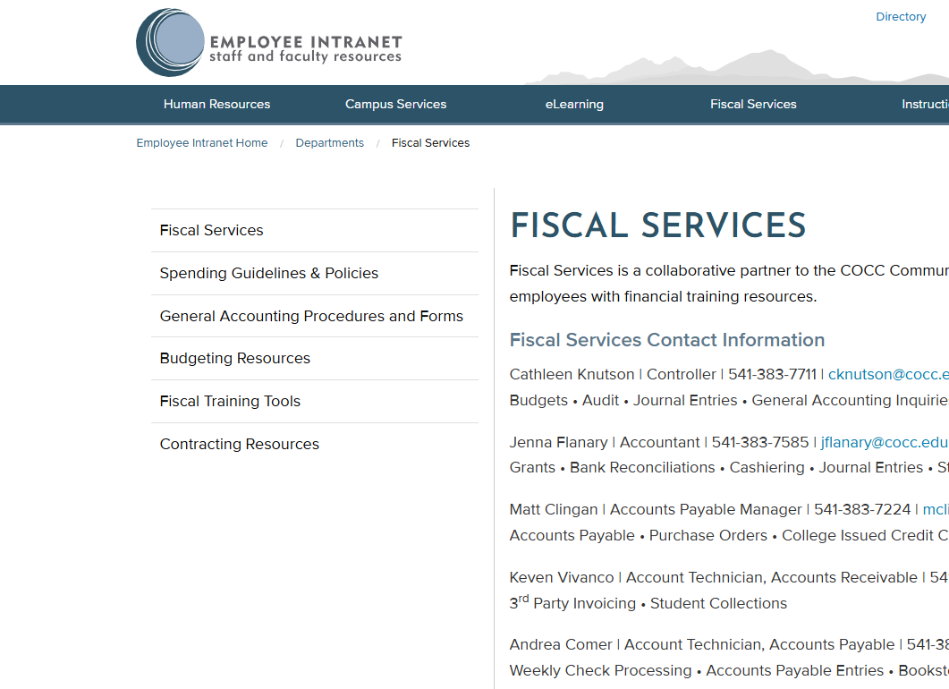


New Contracting Resources on the
Fiscal Intranet
Fiscal Services → Contracting Resources
Contract Submission Form
Use this to submit new contracts for review and signature.
Contract Templates
Use approved templates for common contract needs.
Click here to access resources

Slide 11
Employee Awards, Recognitions, Celebrations, and Professional Development
Focused primarily on awards and recognition
  Researched other colleges practices
  Brainstormed strategies – both meaningful and easy to show care and recognition for colleagues (i.e., digital kudos channel, traveling award)
Coming up next year:
  Appreciation stations
  Awards around the year (i.e., great teamwork, student impact, kindness)
Great Colleges to Work For (Spring 2027)
COLLEGE SUSTAINABILITY ACTION PROJECTS

Slide 12
Culturally Inclusive Hiring Practices
Increased out-of-area candidate travel reimbursements ~ $18K utilized from SP fund
  more funds will be needed next year to support this effort
Reviewed, improved, and communicated hiring and selection processes
  hiring instructions, culturally responsive training/practices, and just-in-time communications
  more equitable recruitment practices aimed at stronger, more diverse candidate pools
  focused recruitment advertising costs
COLLEGE SUSTAINABILITY ACTION PROJECTS

Slide 13
Thank you!
Questions?
THANK YOU!
Notes:
Alicia, with Laurie to close

